Slide 1
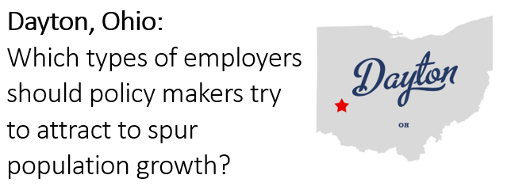

Slide 2
The Problem
The city of Dayton, Ohio has experienced population declines, hurting the city's economic prospects.
From Wikipedia: "Since the 1980s, {...] Dayton's population has declined, mainly due to the loss of manufacturing jobs and decentralization of metropolitan areas, as well as the national housing crisis that began in 2008. While much of the state [of Ohio] has suffered for similar reasons, the impact on Dayton has been greater than most. Dayton had the third-greatest percentage loss of population in the state [of Ohio] since the 1980s, behind Cleveland and Youngstown. Despite this, Dayton has begun diversifying its workforce from manufacturing into other growing sectors such as healthcare and education."

Slide 3
The Questions
Will Dayton’s healthcare and education initiatives spur population growth?
Does Dayton's employer portfolio have major differences compared to faster-growing cities of similar size? If so, what decisions can policymakers make to promote faster population growth?

Slide 4
The Analysis
I started by identifying cities that were similar in size to Dayton in the 2010 census, using a readily-available city population list on Wikipedia.
Then I performed a statistical analysis to determine which city census measures and city-level business category proportions correlated most strongly with population growth. This required retrieving and summarizing large volumes of additional data from US Census QuickFacts, SimpleMaps, and Foursquare.

Slide 5
The Results
The analysis confirmed that Dayton’s business portfolio is substantially different compared to faster-growing cities.
Furthermore, the analysis showed strong correlations between certain city-level business category proportions and population growth.
The analysis results suggest that Dayton’s business portfolio proportions are symptomatic and/or the cause of its recent population declines.
The analysis results did not show a strong link between population growth and the supply of healthcare and education providers.

Slide 6
The Conclusion
Dayton’s initiatives toward growing the education and healthcare sectors are a maintenance measure at best and have little correlation with short-term population growth.
Dayton’s economic portfolio has an overabundance of service providers, which be hurting competition and inhibiting innovation in other sectors.
Dayton policymakers should consider implementing negative tax incentives to reduce the proportion of service providers, then allocate the tax revenues into promoting and building residential, cultural, recreational, commercial, and transportation infrastructure.

